Slide 1
State of Play FEDeRATED
Architecture Board
Living Labs workshop
23 February 2021

Slide 2
Context
FEDeRATED Living Labs Workshop, state of Play Architecture 23022021

Slide 3
http://www.federatedplatforms.eu/index.php/library/category/2-masterplan
Leading principles (lets skip these, please consult the website)
Compliance with existing rules
Business Services
Supply and logistics chains
Data requirements of enterprises
Data requirements established by an authority
Data processing
Fit for purpose
Publication of data requirements
Authority services
Push/Pull
Publish/Subscribe
Combining data requirements
Data sovereignty
Data at the source
Data sets
Baseline standards
Data timestamps
Unique identifiers(s) of data (sets)
Data sharing solution
Data validation
FEDeRATED Living Labs Workshop, state of Play Architecture 23022021

Slide 4
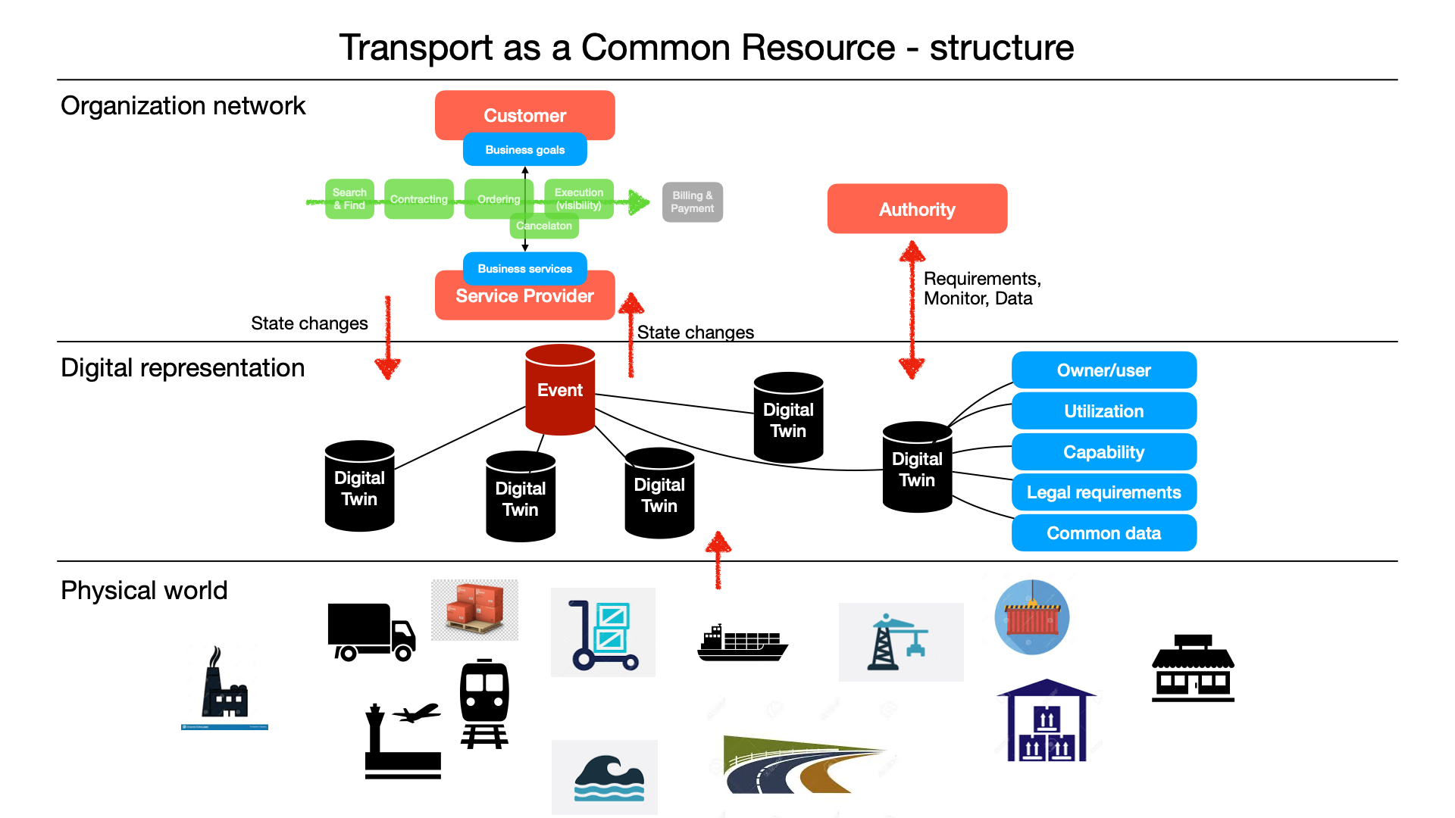
Relation between actors, objects and events
FEDeRATED Living Labs Workshop, state of Play Architecture 23022021

Slide 5
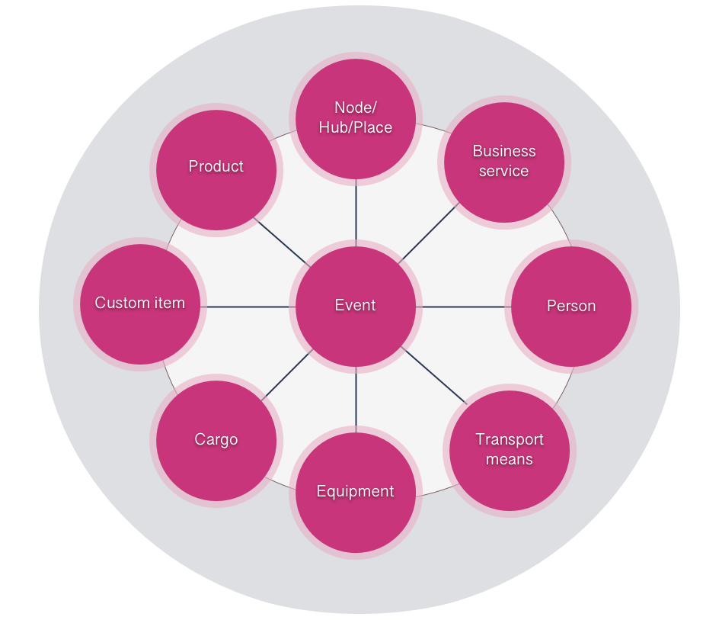
Information items
FEDeRATED Living Labs Workshop, state of Play Architecture 23022021

Slide 6
Development of Elements of Building
Semantics
Choreography
Unique identification
Application APIs (generic services)
Identity and Authentication
Data exchange techniques (API/Broker)
Access control
Search systems
Logistics services registers
API Registry
Log and audit trails
Platform
Access points
Infrastructure components, storage
Governance
SERVICE 2022
EMSWe data sharing port handling
Data sharing eFTI platform
Pull data accessibility logistics, incl aircargo
SERVICE 2025
Analysis Scan data
eGovernment risk management
Green logistics
Automated Customs compliance
Transport
mode
Business process incl data
Shipper
Business process incl data
Authority
Business process incl data
Terminal
operator
Business process incl data
Forwar
der
Business process incl data
Outcome: Applicable leading principles + content elements of building
FEDeRATED Living Labs Workshop, state of Play Architecture 23022021

Slide 7
Semantics
Choreography
Unique identification
Application APIs (generic services)
Identity and Authentication
Data exchange techniques (API/Broker)
Access control
Search systems
Logistics services registers
API Registry
Log and audit trails
Platform
Access points
Infrastructure components, storage
Governance
Identification & Authentication
Who?
  Actors in the FEDeRATED network;
    Companies
    IT-Service providers
    Authorized entities
What?
  Will be identified and authenticated;
    S-2-S on company level
    H-2-S on company level and role level
When?
  At the moment they want to access data or using services;
    Valid for a specific time period
Where?
  which are available in the federated platform;
    Each platform connects to agreed and unified manner
Why?
  so that the holder of data or services know how makes use of it and can act on it;
    Prerequisite for authorizing a specific party
    Traceability and auditability
FEDeRATED Living Labs Workshop, state of Play Architecture 23022021

Slide 8
Semantics
Choreography
Unique identification
Application APIs (generic services)
Identity and Authentication
Data exchange techniques (API/Broker)
Access control
Search systems
Logistics services registers
API Registry
Log and audit trails
Platform
Access points
Infrastructure components, storage
Governance
Authorisation Framework (Access Control)
Who?
  Actors in the FEDeRATED network;
    Context of roles; shipper, forwarder, declarant, handler, government
    Power of a user
What?
  Will be identified and authenticated;
    Control on access rights to services or data
When?
  At the moment they want to access data or using services;
    Validity related to context, eg. logistics chain and transport process
Where?
  which are available in the federated platform;
    Data provider/owner grants access rights
Why?
  so that the holder is in control of sharing its own data or services with other actors in the federated platforms.
    When data is kept at source, i.e. with the party that has created or originated the data, authorization give them full control and data sovereignty.
FEDeRATED Living Labs Workshop, state of Play Architecture 23022021

Slide 9
Semantics
Choreography
Unique identification
Application APIs (generic services)
Identity and Authentication
Data exchange techniques (API/Broker)
Access control
Search systems
Logistics services registers
API Registry
Log and audit trails
Platform
Access points
Infrastructure components, storage
Governance
API Broker Registry
Who?
  Data Providers
What?
  Broker or through standardized interfaces
When?
  Quality assured data/services should be available for authorized consumers at right time
Where?
  To a broker or brokers
Why?
  in order to always base decisions on updated knowledge
FEDeRATED Living Labs Workshop, state of Play Architecture 23022021

Slide 10
Semantics
Choreography
Unique identification
Application APIs (generic services)
Identity and Authentication
Data exchange techniques (API/Broker)
Access control
Search systems
Logistics services registers
API Registry
Log and audit trails
Platform
Access points
Infrastructure components, storage
Governance
API Index Registry
Who?
  Categorized data/service providers and consumers, both businesses and administrations
    Data providers and consumers, both businesses and administrations
What?
  APIs should be specified and registered in a standardized way
    Data distribution needs to be standardized and “live time”
When?
  Quality assured data/services should be available for authorized consumers at right time
    Event driven data distribution
Where?
  Central instance vs federation of several instances
    Data brokers can be centralised (with redundancy) or distributed
Why?
  Discoverability of quality assured services
    Better coordination and common situational awareness, especially important in very distributed networks, require better and more up to date flow of information
FEDeRATED Living Labs Workshop, state of Play Architecture 23022021

Slide 11
Semantics
Choreography
Unique identification
Application APIs (generic services)
Identity and Authentication
Data exchange techniques (API/Broker)
Access control
Search systems
Logistics services registers
API Registry
Log and audit trails
Platform
Access points
Infrastructure components, storage
Governance
(meta data) Search engine
Who?
  Any authority or participating party
What?
  will retrieve a link to data
    An index (with a URI)
    Itineraries of transport means with places of call where cargo is loaded/discharged
    Cargo tracks linking the cargo moving from one itinerary of a transport means to that of another transport means
    Provenance of the products in the cargo
When?
  at the moment they require it for their processes (request based)
    There is a large variety of business processes, depending on the implementation and of regulations by authorities.
Where?
  from the meta data search engine
    The meta data search engine contains the index with the links (URIs) to external data sources. The metadata search engine will only provide access to that part of the index, that an authority is allowed to access
Why?
  to make their logistics flows more efficient and effective
    Each authority or participating party will have particular business processes. By having access to external data, the data quality increases, which improves their decision making.
FEDeRATED Living Labs Workshop, state of Play Architecture 23022021

Slide 12
Semantics
Choreography
Unique identification
Application APIs (generic services)
Identity and Authentication
Data exchange techniques (API/Broker)
Access control
Search systems
Logistics services registers
API Registry
Log and audit trails
Platform
Access points
Infrastructure components, storage
Governance
What about the rest?
Functional requirements or implementation choices:
  Log and audit trails
  Platforms
  Access points
  Infrastructure components/storage
FEDeRATED Living Labs Workshop, state of Play Architecture 23022021

Slide 13
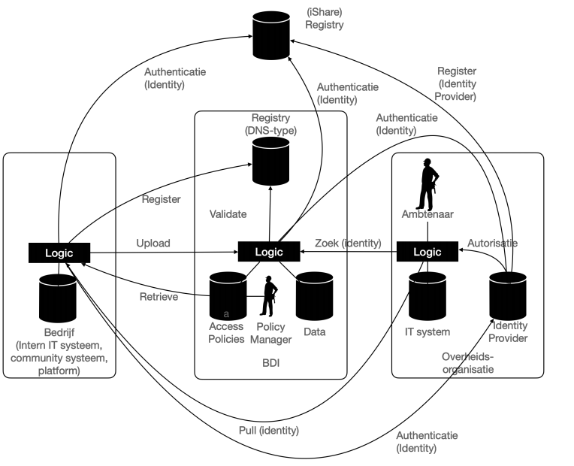
Simplified view on architecture
FEDeRATED Living Labs Workshop, state of Play Architecture 23022021

Slide 14
Next steps
Finalize high level architecture
Further detailing of Elements of Building
Define detailed interactions between Elements of Building
Define interfaces
Together:
  Verify Elements of Building based on Living Labs. How can we connect multiple Living Labs while making use of the Elements of Building?
Notes:
Joined action: identify LL’s to combine and serve as a show-case in integrating the Elements of Building. This could serve as a reference implementation for future implementations.

Slide 15
QUESTIONS?
Mitchell Out
Chiarman IT Architecture Board
mp.out@belastingdienst.nl

